Slide 1

Smart Home Monitoring System
Module
Rohit Kumar

Slide 2
Contents
Title | Page
Introduction
Hardware Required
Description
Smart home monitoring system Algorithm
Connecting Raspberry Pi to 000webhost free web hosting site
Creating Database and table
Setup connection with database
Accessing data in phpMyAdmin Database

Slide 3
Smart Home Monitoring System
The purpose of this system is to find temperature (in Celsius and Fahrenheit), humidity in our homes and also automate the lights of our garden according to darkness or brightness of surrounding. It also has security system so that if any moving object is detected in our home, it will activate the security alarm so that the owner of the home get to know about any mis-happening in home.

Slide 4
Hardware requirements
Raspberry Pi
Pir Sensor
Temperature sensor
Light Depending Resistance(LDR)
Mini Usb cable
Resistors
Capacitances
Breadboard
Jumper Wires

Slide 5
Description
Here, I use three sensors with raspberry pi to find temperature, humidity , presence of object and to automate lights of garden according to darkness or brightness of surrounding.
Temperature sensor- DHT11 is used to find temperature and humidity of home.
LDR- Light dependent resistance is sensitive to light. When light falls upon it then the resistance changes. And accordingly switch on/off the lights of garden of my home.
PIR sensor- A PIR or a Passive Infrared Sensor can be used to detect presence of human beings in its proximity. The output can be used to control the alarm.

Slide 6
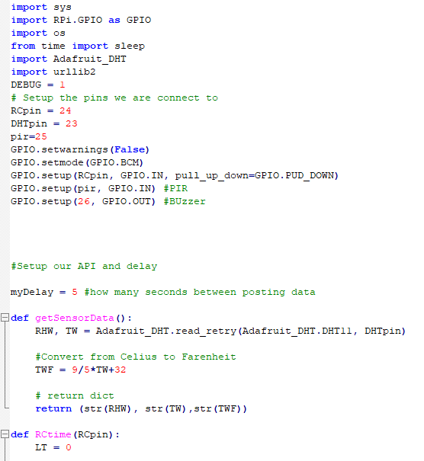
Open the terminal and create a file by using this command :-
sudo nano filename.php
And write the code as above. Connect the DHT11 to pin 23, LDR to pin 24 and Pir sensor to pin 25 of raspberry pi.
After getting complete with code press ctrl+o -> enter then press ctrl+x to exit.

Slide 7
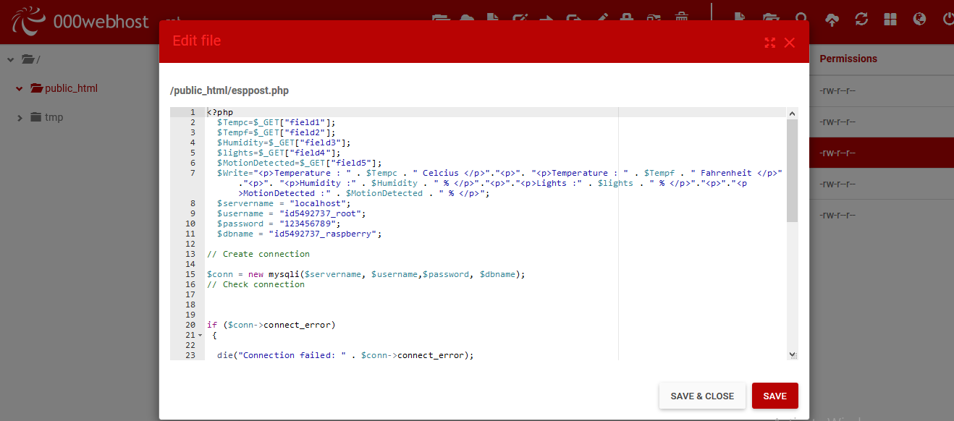
Create your account and login in https://www.000webhost.com/ .
Navigate to file manager tab and create a new file with .php extension.
And write your code for communication between hardware and database.
Then navigate to manage database tab and create a new database.

Slide 8
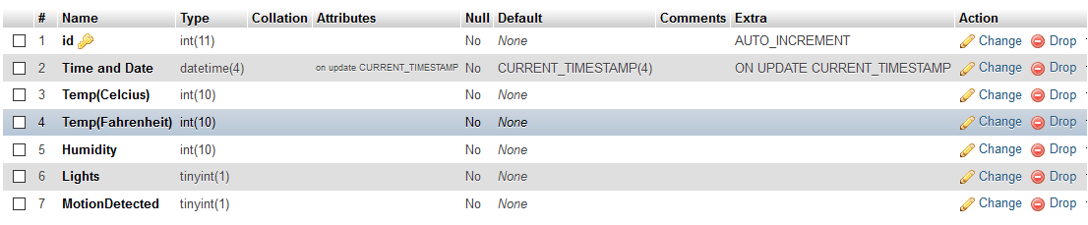
Click on New tab -> Enter the name of database and then click on create.
Now enter the name of table and set no. of columns to 7.
Fill the entries in columns same as image above.
Now we are done with database.

Slide 9
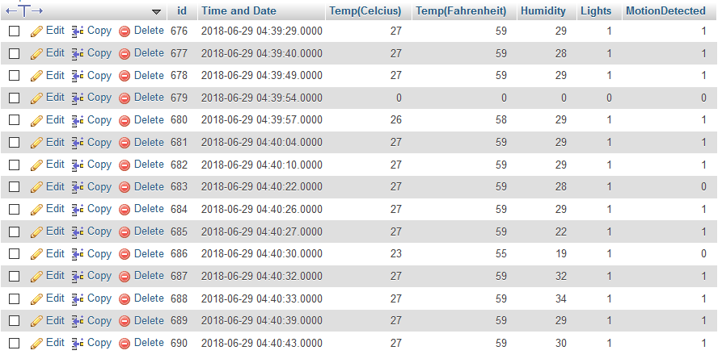
Enter <sudo python filename.php> command on terminal.
Then you will get the values of your sensors and timestamp in phpMyAdmin database.

Slide 10
Thank You !
Contact US
Nitin Sinha
nitin.sinha@goSigmaWay.com
+1 727-394-4375
+91 7838188809
Debjani Mitra
debjani.mitra@goSigmaWay.com
+1 952-583-3449
+91 9339555636
Rohit Kumar
rohit.kumar@sigmaway.us
+91 7982577830
+91 7838021754

